Slide 1


Cookieless Tracking Conversion API

Slide 2
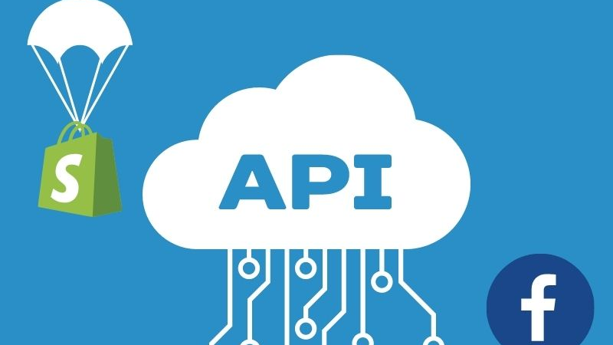
CAPI Tool Creation

Slide 3
Prerequisites for CAPI
Proposal | CAPI
Pixel ID: To tie up all conversion events and user information
Business Manager: To use API
Access Token: You can get that using Events Manager or using your own app
Conversion API is built on Marketing API, which is further built on top of Graph API.
Conversion API accepts POST requests

Slide 4
Tasks to be conducted from our end I
Proposal | CAPI
Create Subdomain for clients: PS
Map subdomain to our server: Client
Send following information about customers at conversion events:
em: Email — Hashing required
ph: Phone Number — Hashing required
fn: First Name — Hashing required
ln: Last Name — Hashing required
ge: Gender — Hashing
required
db: Date of Birth — Hashing required
st: State — Hashing required
zp: Zip Code — Hashing required
ct: City — Hashing required
country: Country — Hashing required
external_id: External ID — Hashing recommended
client_ip_address: Client IP Address — Do not hash
client_user_agent: Client User Agent — Do not hash
fbc: Click ID — Do not hash
fbp: Browser ID — Do not hash
subscription_id: Subscription ID — Do not hash
fb_login_id: Facebook Login ID — Do not hash
lead_id: Lead ID — Do not hash

Slide 5
Tasks to be conducted from our end II
Proposal | CAPI
These are the prominent conversion events:
AddPaymentInfo
AddToCart
AddToWishlist
InitiateCheckout
Lead
PageView
Purchase
Search
CompleteRegistration
ViewContent

Slide 6
Tasks to be conducted from our end III
Proposal | CAPI
Implementation code will be sitting on our server
Client server has to send event to our server through API call (maybe) to initiate the call to Facebook Conversion API
The data that is to be sent over to FB can be a part of this API

